Slide 1
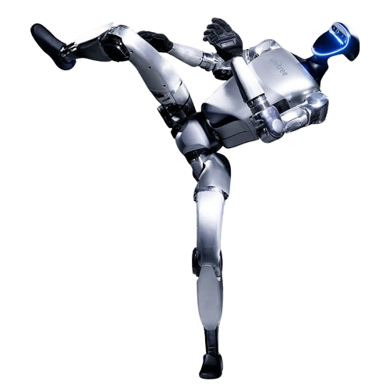
Dancing Robot:
the basic application of unitree G1
By:Furui Xiao

Slide 2
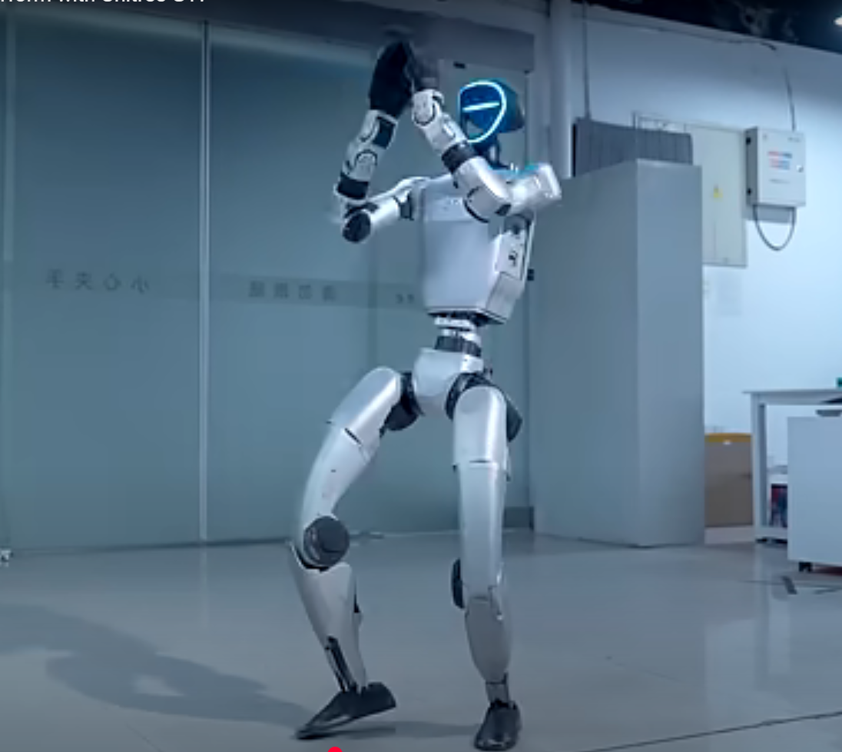
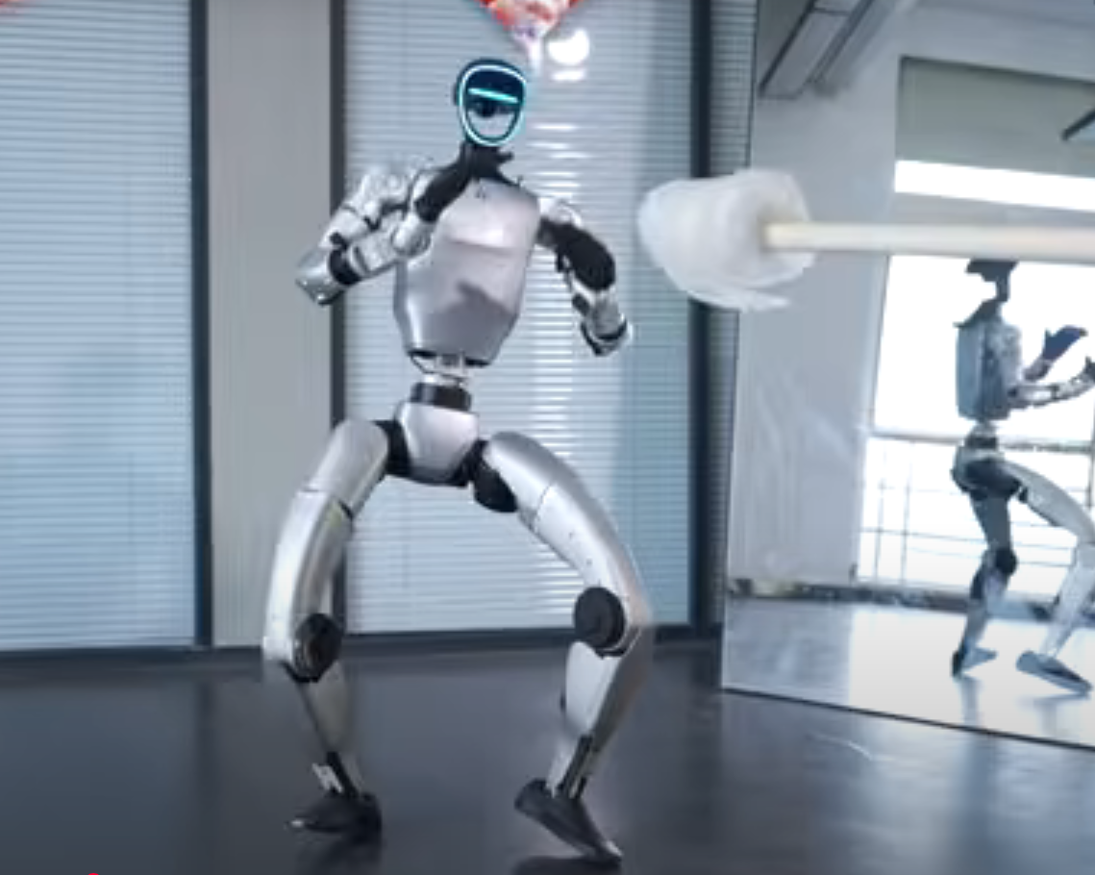
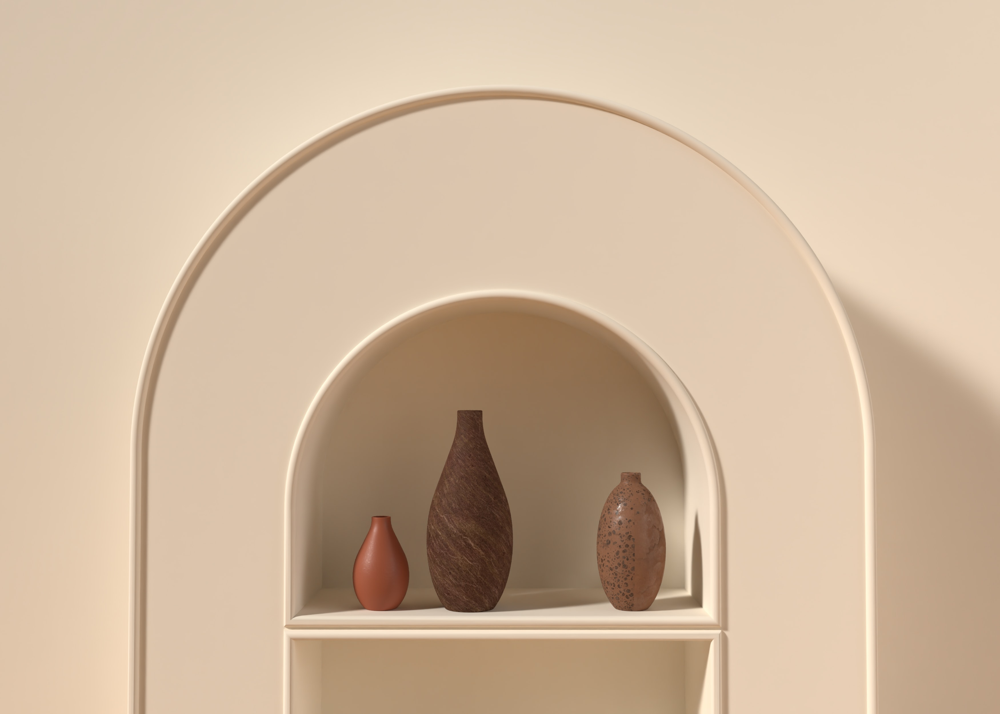
What we saw?
An example video of robot dance from unitree
Test the robot's stability by giving it a punch while it dances
添加小标题
添加小标题
https://www.youtube.com/watch?v=p0xFou30hWI
https://www.youtube.com/watch?v=eZ8BOd3ERoo

Slide 3
What we want G1 do?
In general, we want to let G1 dance to music
Step 1: Make a slight movement and get the BPM at this time
Step 2: Choose appropriate dance moves based on BPM and align with the music beat
The core is: How to make robots learn different dance movements and keep the beat

Slide 4
Challenges
Connect between ROS and simulator
Keep balance while walking or dacing
Learn different dancing movements
Temporal Coordination for aligning the beat

Slide 5
How to do that?
To learn different dance movements,threre are two strategies:
1st. Make clear understanding of most joints eidt every joints’ moves
2nd. Through reinforcement learning, use Imitation Rewards to make it learn some dance moves
To let G1 keep the beat:
Implement CNN-LSTM network for beat prediction
Latency Compensation

Slide 6
Why to do that?
Personal Value:
Make more knowledge of G1 robot, make basement for later advance research.
Comprehend ROS as the middleware in robotics.
Apply the knowledge learned in class.
(possible)Applications Value:
1) Entertainment Robotics
2) Medical Rehabilitation Systems

Slide 7
How to evaluate?
System Integration and Communication
Gait and Dance Move Performance
Communication Latency & Reliability
Platform Connectivity
Trajectory Accuracy
Repeatability
Subjective Dance Quality
25%
25%
Beat Synchronization
System Robustness and Safety
Beat Detection Accuracy
Synchronization Timing (delay test)
Can it maintain balance under some impact?
Error Handling & Recovery
25%
25%
(optional) Deploy to real G1 robots
+20%
Connect with a real G1 robot to apply this project

Slide 8
Questions?
I have uploaded this slide to github, if you have any questions, feel free to ask me there.

